Slide 1
Introduction to Machine Learning: CS 436/580L Bayesian Networks
Instructor: Arti Ramesh
Binghamton University

Slide 2
Bayesian networks
One of the most exciting advancements in statistical AI and machine learning in the last 10-15 years
Generalizes naïve Bayes and logistic regression classifiers
Compact representations of exponentially-large probability distributions
Exploit conditional independences
Judea Pearl: Turing award in 2011 for his contributions to Bayesian networks

Slide 3
Causal Structure
Draw a directed acyclic (causal) graph for the following
Direct arrows from cause to effect
Story:
There is a Burglar alarm that rings when we have Burglary
However, sometimes it may ring because of earthquake

Slide 4
A Bayesian Network
A Bayesian network is made up of two parts:
A directed acyclic graph
A set of parameters
B | P(B)
false | 0.999
true | 0.001
E | P(E)
false | 0.998
true | 0.002
Burglary
Earthquake
Alarm
B | E | A | P(A|B,E)
false | false | false | 0.999
false | false | true | 0.001
false | true | false | 0.71
false | true | true | 0.29
true | false | false | 0.06
true | false | true | 0.94
true | true | false | 0.05
true | true | true | 0.95

Slide 5
A Directed Acyclic Graph
Burglary
Earthquake
Alarm
1. A directed acyclic graph:
The nodes are random variables
Arrows connect pairs of nodes (X is a parent of Y if there is an arrow from node X to node Y).

Slide 6
A Directed Acyclic Graph
Burglary
Earthquake
Alarm
Intuitively, an arrow from node X to node Y means X has a direct influence on Y (we can say X has a casual effect on Y)
Easy for a domain expert to determine these relationships

Slide 7
A Set of Parameters
B | P(B)
false | 0.999
true | 0.001
E | P(E)
false | 0.998
true | 0.002
Burglary
Earthquake
Alarm
B | E | A | P(A|B,E)
false | false | false | 0.999
false | false | true | 0.001
false | true | false | 0.71
false | true | true | 0.29
true | false | false | 0.06
true | false | true | 0.94
true | true | false | 0.05
true | true | true | 0.95
Each node X_{i} has a conditional probability distribution P(X_{i} | Parents(X_{i})) that quantifies the effect of the parents on the node
The parameters are the probabilities in these conditional probability distributions
Because we have discrete random variables, we have conditional probability tables (CPTs)

Slide 8
A Set of Parameters
Conditional Probability Distribution for Alarm
Stores the probability distribution for Alarm given the values of Burglary and Earthquake
B | E | A | P(A|B,E)
false | false | false | 0.999
false | false | true | 0.001
false | true | false | 0.71
false | true | true | 0.29
true | false | false | 0.06
true | false | true | 0.94
true | true | false | 0.05
true | true | true | 0.95
For a given combination of values of the parents (B and E in this example), the entries for P(A=true|B,E) and P(A=false|B,E) must add up to 1 eg. P(A=true|B=false,E=false) + P(A=false|B=false,E=false)=1
If you have a Boolean variable with k Boolean parents, how big is the conditional probability table?
How many entries are independently specifiable?

Slide 9
Semantics of Bayesian Networks

Slide 10
Bayes Nets Formalized
A Bayes net (also called a belief network) is an augmented directed acyclic graph, represented by the pair V , E where:
V is a set of vertices.
E is a set of directed edges joining vertices. No loops of any length are allowed.
Each vertex in V contains the following information:
The name of a random variable
A probability distribution table indicating how the probability of this variable’s values depends on all possible combinations of parental values.

Slide 11
Semantics of Bayesian Networks
Two ways to view Bayes nets:
A representation of a joint probability distribution
An encoding of a collection of conditional independence statements

Slide 12
Bayesian Network Example
Weather
Cavity
Toothache
Catch
P(A|B,C) = P(A|C)
I(ToothAche,Catch|Cavity)
Weather is independent of the other variables, I(Weather,Cavity) or P(Weather) = P(Weather|Cavity) = P(Weather|Catch) = P(Weather|Toothache)
Toothache and Catch are conditionally independent given Cavity
I(Toothache,Catch|Cavity) meaning P(Toothache|Catch,Cavity) = P(Toothache|Cavity)

Slide 13
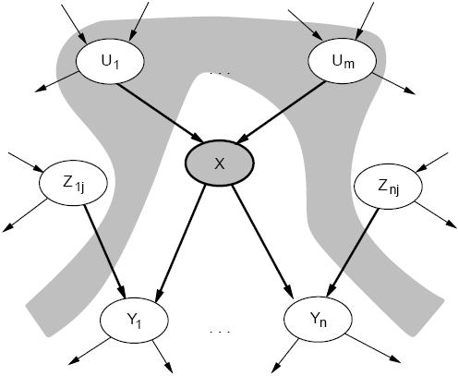
Conditional Independence
We can look at the actual graph structure and determine conditional independence relationships.
A node (X) is conditionally independent of its non-descendants (Z_{1j}, Z_{nj}), given its parents (U₁, U_{m}).
Markov blanket: parents, children, and parents of children

Slide 14
A Representation of the Full Joint Distribution
We will use the following abbrevations:
P(x₁, …, x_{n}) for P( X₁ = x₁ ∧ … ∧ X_{n} = x_{n})
parents(X_{i}) for the values of the parents of X_{i}
From the Bayes net, we can calculate:

Slide 15
The Full Joint Distribution
( Chain Rule)
( Chain Rule)
( Chain Rule)

Slide 16
The Full Joint Distribution
To be able to do this, we need two things:
Parents(X_{i}) ⊆ {X_{i-1}, …, X₁}
This is easy – we just label the nodes according to the partial order in the graph
We need X_{i} to be conditionally independent of its predecessors given its parents
This can be done when constructing the network. Choose parents that directly influence X_{i}.

Slide 17
Example
Burglary
Earthquake
Alarm
JohnCalls
MaryCalls
P(JohnCalls, MaryCalls, Alarm, Burglary, Earthquake)
= P(JohnCalls | Alarm) P(MaryCalls | Alarm ) P(Alarm | Burglary, Earthquake ) P( Burglary ) P( Earthquake )

Slide 18
Conditional Independence
There is a general topological criterion called d-separation
d-separation determines whether a set of nodes X is independent of another set Y given a third set E

Slide 19
D-separation
We will use the notation I(X, Y | E) to mean that X and Y are conditionally independent given E
Theorem [Verma and Pearl 1988]:
If a set of evidence variables E d-separates X and
Y in the Bayesian Network’s graph, then
I(X, Y | E)
d-separation can be determined in linear time using a DFS-like algorithm

Slide 20
D-separation
Let evidence nodes E ⊆ V (where V are the vertices or nodes in the graph), and X and Y be distinct nodes in V – E.
We say X and Y are d-separated by E in the Bayesian network if every undirected path between X and Y is blocked by E.
What does it mean for a path to be blocked? There are 3 cases…

Slide 21
Case 1
There exists a node N on the path such that
It is in the evidence set E (shaded blue)
The arcs putting N in the path are “tail-to-tail”.
X
N
Y
X = “Owns expensive car”
N = “Rich”
Y = “Owns expensive home”
The path between X and Y is blocked by N

Slide 22
Case 2
There exists a node N on the path such that
It is in the evidence set E
The arcs putting N in the path are “tail-to-head”.
X
N
Y
X=Education N=Job Y=Rich
The path between X and Y is blocked by N

Slide 23
Case 3
There exists a node N on the path such that
It is NOT in the evidence set E (not shaded)
Neither are any of its descendants
The arcs putting N in the path are “head-to-head”.
X
N
Y
The path between X and Y is blocked by N (Note N is not in the evidence set)

Slide 24
Case 3 (Explaining Away)
Burglary
Earthquake
Alarm
Your house has a twitchy burglar alarm that is also sometimes triggered by earthquakes
Earth obviously doesn’t care if your house is currently being broken into
While you are on vacation, one of your nice neighbors calls and lets you know your alarm went off

Slide 25
Case 3 (Explaining Away)
Burglary
Earthquake
Alarm
But if you knew that a medium-sized earthquake happened, then you’re probably relieved that it’s probably not a burglar
The earthquake “explains away” the hypothetical burglar
This means that Burglary and Earthquake are not independent given Alarm.
But Burglary and Earthquake are independent given no evidence ie. learning about an earthquake when you know nothing about the status of your alarm doesn’t give you any information about the burglary

Slide 26
d-separation Recipe
To determine if I(X, Y | E), ignore the directions of the arrows, find all paths between X and Y
Now pay attention to the arrows. Determine if the paths are blocked according to the 3 cases
If all the paths are blocked, X and Y are d-separated given E
Which means they are conditionally independent given E

Slide 27
Conditional Independence
Note: D-separation only finds random variables that are conditionally independent based on the topology of the network
Some random variables that are not d-separated may still be conditionally independent because of the probabilities in their CPTs

Slide 28
Relationship to Naïve Bayes
Distribution?
Class
X₁
X₂
X_{n}
Number of parameters?

Slide 29
Bayesian Inference Example

Slide 30
Bayesian Inference Example
Full joint distribution as the product of local conditional distributions

Slide 31

Bayesian Inference Example
What is the probability distribution of Burglary given that John and Mary call?
P(B | j = true, m = true)
= P(B | j, m)
= P(B, j, m) / P(j , m)
= α P(B, j, m)
=

Slide 32
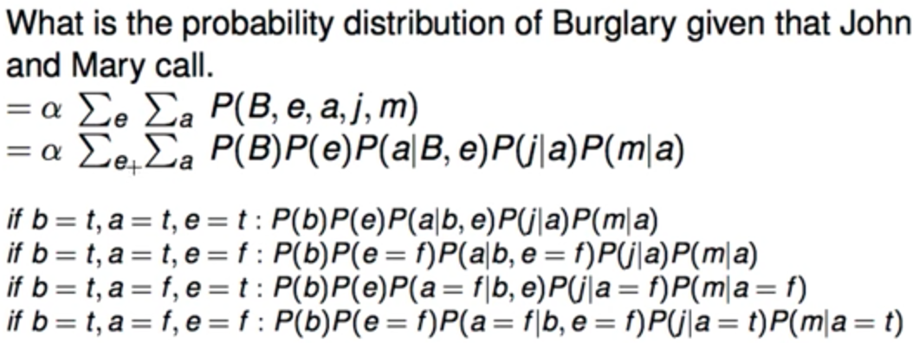
Bayesian Inference Example

Slide 33
Real Bayesian networks applications
Diagnosis of lymph node disease
Speech recognition
Microsoft office and Windows
http://www.research.microsoft.com/research/dtg/
Study Human genome
Robot mapping
Robots to identify meteorites to study
Modeling fMRI data
Anomaly detection
Fault dianosis
Modeling sensor network data

